Slide 1
^{DSI Capstone} ^{10/31 Weekly Update}
Nov 3, 2022

Slide 2
Agenda
1
From Last Week
2
Modeling Deep Dive: Optimization on Gurobi
3
Business Implementation Expectation
4
Next Steps

Slide 3
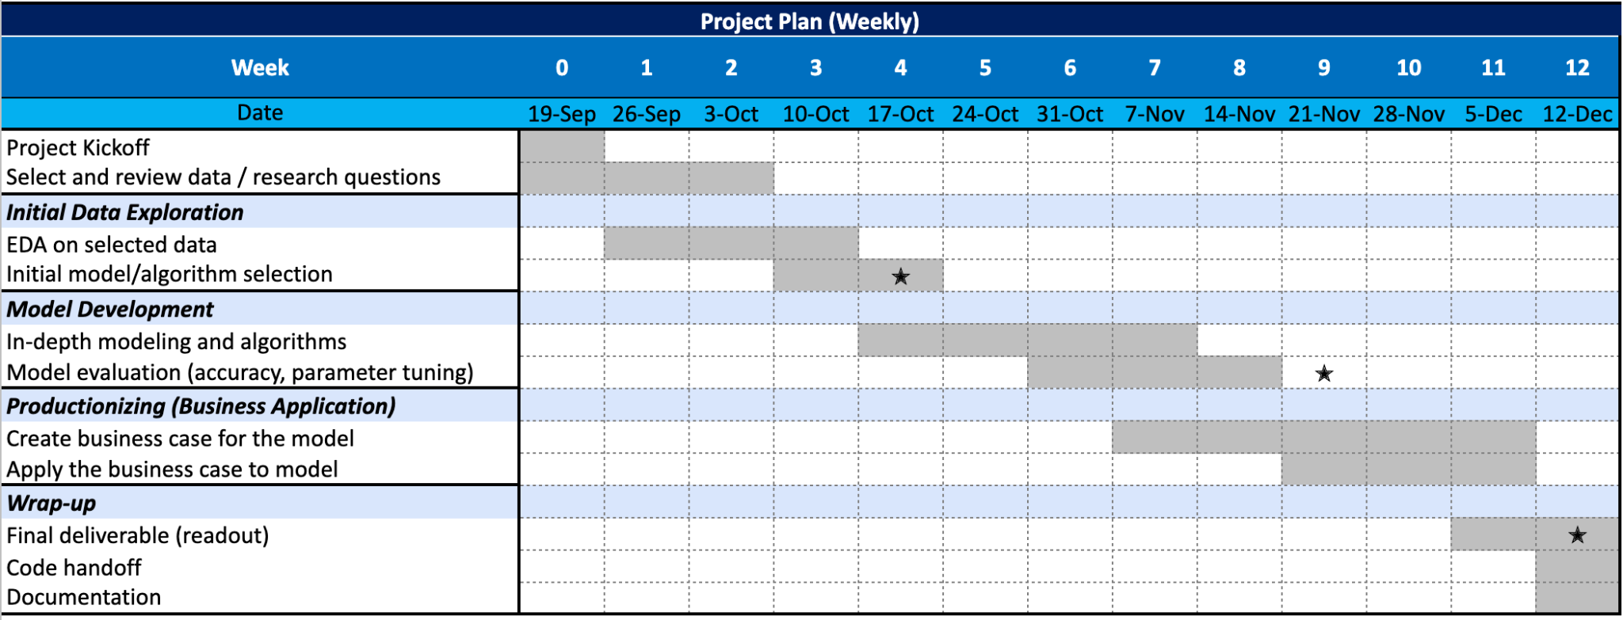
From Last Week: Timeline
1
1st progress report

Slide 4
From Last Week
1
Action items:
Apply the current brute-forced optimization model onto pyomo for faster solvers and see modeling results
Transfer data into useful format
Formulate objective functions and constraints on pyomo/Gurobi

Slide 5
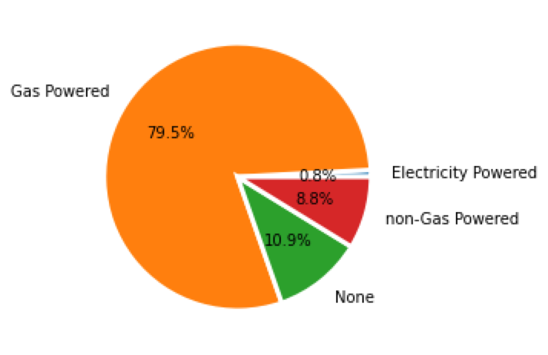
Modeling Deep Dive: Optimization on Gurobi
2
Variable
Each gas station location
(output will be 0: don’t put EV station there, or 1: put a new EV station there)
Average EV traffic coverage per station within 1 miles based on current state (ratio¹):
261
Objective function
Minimize new charging stations count (sum of all variables)
Constraints
Fixed constraints:
Driving distance to highway exit < 1 miles
Risk rating from NRI is not Very High
No additional new EV stations appearing in 1 mile straight line radius
Constraints varied by variables:
All traffic demand satisfied:
(New EV station cnt + # of existing EV station within 5 miles)* ratio¹ >= EV traffic cnt
1. total traffic ratio = traffic count within 1 miles / # of EV stations within 1 miles for each Seattle (busy) area I-5 exits
take the average of each ratio on exits and come to the final ratio
To approximate the EV traffic, we multiply the total traffic by 0.8%
From the pie chart, EV account for 0.8% of all registered vehicles

Slide 6
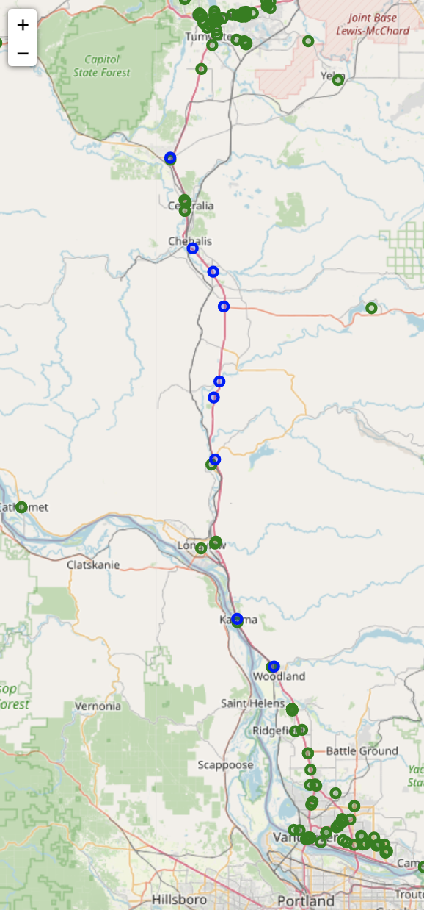
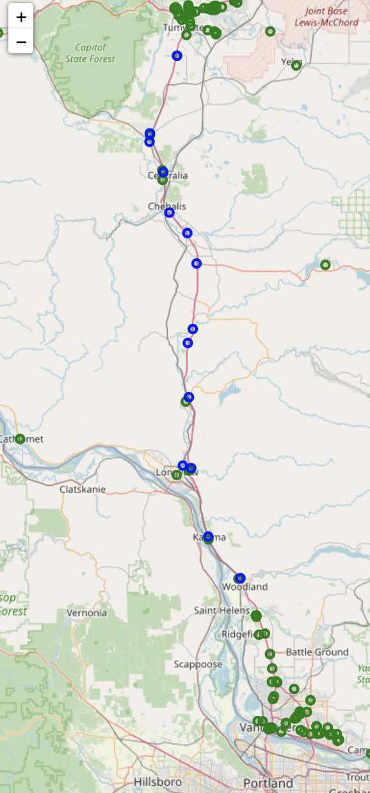
Result - Low Demand Scenario
2
: Existing EV charging location
: Suggested new EV charging location
Current state
EV% = 0.8%
Suggested 9 locations
Low demand state
EV% = 2%
Suggested 14 locations
There are existing demand in rural areas for new EV stations
As demand increases, the difference (circled area) is:
Added more EV station in locations where there are existing EV chargers
This situation may be solved by increasing more chargers (capacity) in existing locations
Model version: pandas: 1.3.5, gurobipy: 9.5.2 (detail see appendix)

Slide 7
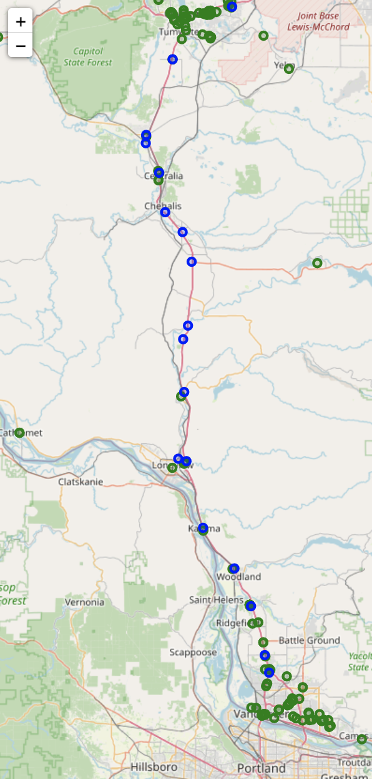
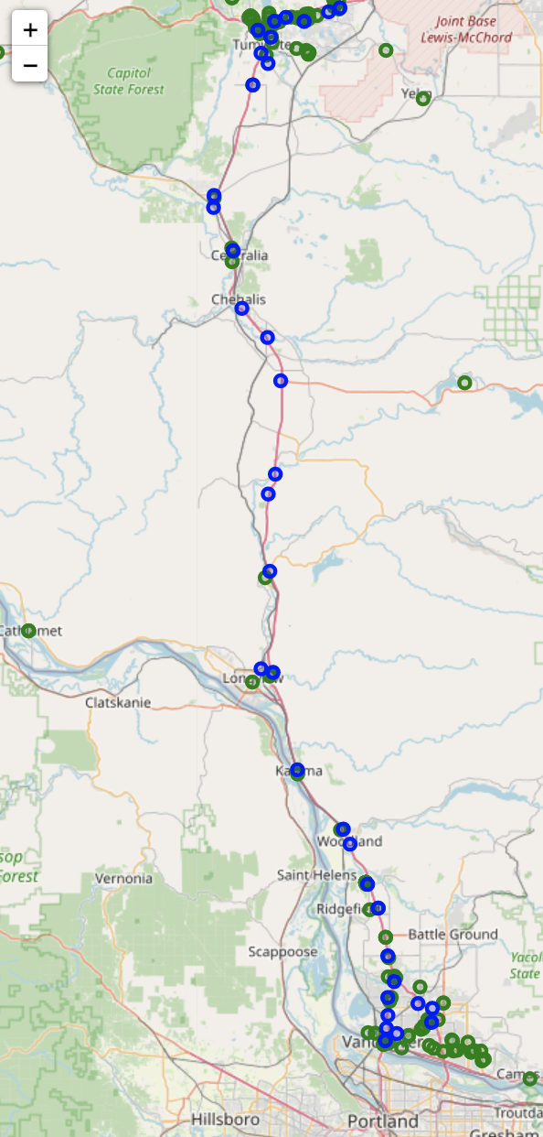
Result - Medium/High Demand Scenario
2
: Existing EV charging location
: Suggested EV charging location
Medium demand state
EV% = 4%
Suggested 18 locations
High demand state
EV% = 10%
Suggested 36 locations
The difference between low and medium demand are not significant
As demand increases more, the difference (circled area) is:
Most demand increased in urban area
This situation may also be solved by increasing more chargers (capacity) in existing urban locations
Model version: pandas: 1.3.5, gurobipy: 9.5.2 (detail see appendix)

Slide 8
Business Implementation Expectation
3
Proposal
Data-access difficulty
(depending on how complex the cost model will be…)
◑
1
Take cost into account when placing EV charging locations and calculate the expected gain/loss of applying our model into real life
◕
2
Select another state to see the performance of our model

Slide 9
Next Steps
4
Action items:
Apply the current optimization model on other available routes
We currently have data for I-5, I-90 and I-82 route
Improve the model by incorporating # of chargers and cost
Prepare data for business implementation phase

Slide 10
Appendix

Slide 11
Python Libraries Used
pandas: 1.3.5
numpy: 1.21.6
gurobipy: 9.5.2
geopy: 1.17.0
folium: 0.12.1.post1
requests: 2.23.0
json: 2.0.9

